Slide 1
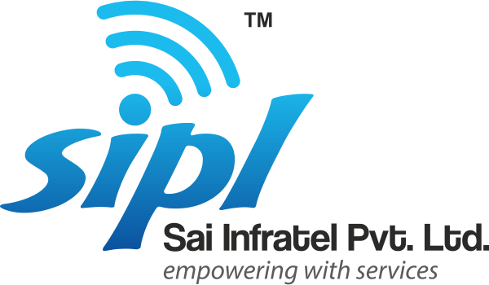

Slide 2
Organization
Profile

Slide 3
O v e r V i e w
SAI-INFRATEL Pvt Ltd. is a leading telecom service provider located in India with wide regional presence.
SIPL has been always keen to develop and deliver excellent business solutions, aiming to increase end-use revenue, enhance satisfaction, and provide a real competitive edge for its customers.
SIPL provide services include systems analysis, solution design, full turnkey implementations for medium and large scale telecom projects, maintenance, training and consultancy.
SIPL is your partner for success. We help you boost your productivity and succeed in an increasingly challenging industry by successfully integrating the latest technology solutions that deliver today’s mission critical services and solutions.

Slide 4
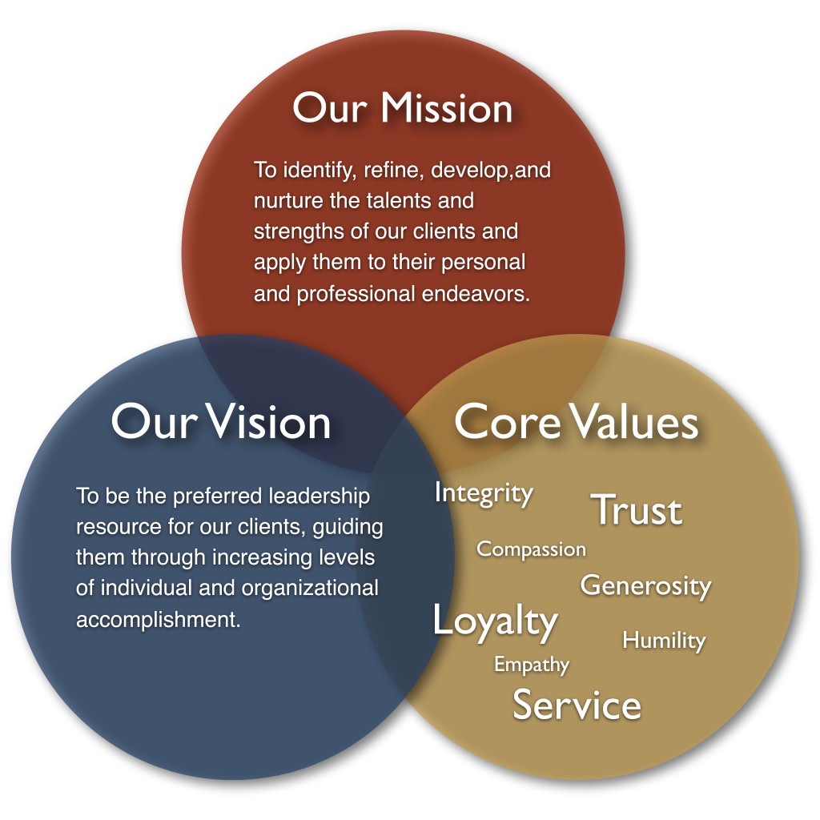

Slide 5
Introduction
Sai Infratel Pvt Ltd is a global telecommunication systems & solutions vendor operating for over 6 years in the market. The company was derived from Sri Sai Communication(SSC), a company that began operating in 2009 in MP, India. SSC was transformed into a Private Limited company and the telecommunications business unit became a company under the name Sai Infratel Pvt Ltd.
We render our service each day to over telecom companies located in MPCG. Each our client is handled individually, we prepare an offer specially tailored to his needs & expectations. Apart from the basic array of services we ready to satisfy even the most specific expectations/ wishes of our clients.
The main area of company’s activity is providing comprehensive telecom infra solution. We base our system in modern technology. We don’t limit ourselves to provide service, but we also support our clients from the beginning & through the all activity, we help to solve the problems. We also offer construction & technical support by construction of telecom infrastructure. Our maintenance team is great asset as they are able to identify a problem and repair in very short time.

Slide 6
SIPL offers integrated design, engineering, procurement, construction and project management services in the telecom, Electrical & Civil infrastructure sectors.
SIPL offers turnkey infrastructure & O&M services in sectors of Passive Telecom sites, Power Industries.
SIPL is proud to have satisfied clients in the domestic market in the telecom sector & others.
In its chase of creating value for its customers, stakeholders and its employees, the company is also ISO certified 9001:2008.
SIPL also having a A-Class Contractor License(Electrical).
Introduction

Slide 7
Company Structure
Director
Managing Director
Director
CEO
BDM
Project Head
Technical Head
Infra Manager
O&M Head
Energy Manager
Admin Head
Idea OMCR
Rjio OMCR
EB
Diesel
Account
HR
SCM
Raipur
Bilaspur
CI Raipur
CI Durg
CI Saraypali
CIKanker
CI Jagdalpur
CI Ambikapur
CI Jashpur
CI Bisrampur
CI Bilaspur
CIRaigarh
CI Rajpur
Tech
Tech
Tech
Tech
Tech
Tech
Tech
Tech
Tech
Tech
Tech

Slide 8
Our Strength
Punctuality
Quality
Professionalism
SAI
INFRATEL
Pvt
Ltd.

Slide 9
Our Strength
Customers are referring your products/services to their friends.
Sufficient capital available to grow.
Hiring quality staff.
Competent planning throughout the company.
Powerful staff buy-in on key strategies and initiatives.
Project management & resource coordination.
Strong leadership/staff communication.
Staff training.
Agreed upon core values throughout the organization.
Organization, not just the leadership, understands how the company will
grow in the future.
Company culture is generally open to change.
Competency in forecasting problem areas before they surface.

Slide 10
Our Capabilities
Telecom
As the principal managed Services Company in Central India, SIPL is independent provider of all services in telecom industry.
Passive Infrastructure Operation & Maintenance
Comprehensive & Non Comprehensive operations and maintenance SIPL provides Suggestion, Support and Solutions (SSS Theory) to Telecom Infrastructure looking for to reduce operating cost (OPEX) and boost ‘Uptime’.
Project Management SIPL provides mission critical advice, support and solutions for a wide variety of network projects, including implementation of Microwave Installation, BTS & latest telecom technologies.
Energy Management SIPL is having A-class license & there will be a specialized EB team which will monitor the Electrification of sites and have a proper liaisons with SEB authority.

Slide 11
Our Capabilities
OFC Maintenance
Construction & Maintenance Services in OFC, Route Survey, Trenching, duct laying & Splice Chamber, Patrolling.
Estate Management
New sites acquisition including IBS + Institutional acquisition.
Support to EB related activities.
Lease Renewals.
Legal Permissions.
Annual Maintenance Contract
We also take on comprehensive and non-comprehensive Annual Maintenance Contracts. We accept as true in quality products at competitive rates.

Slide 12
Organization Overview
Particulars | 2012-2013 | 2013-2014 | 2015-2016 | 2016-17 | 2017-18 (Projected)
Infra Uptime (%) | 99.978 | 99.983 | 99.985 | 99.987 | 99.988
Turnover (Cr.) | 1.5 | 1.7 | 2 | 3 Cr | 5.5
Revenue from O&M Services (Telecom) (Cr.) | 1.2 | 1.4 | 1.5 | 2.2 | 3.6
Revenue from EPC Services (Telecom) (Cr.) | 0.3 | 0.2 | 0.3 | 0.55 | 1.5
Revenue from AMC Services (Non Telecom) (Cr.) | 0 | 01 | 0.1 | 0.25 | 0.4
EBITA | 65% | 67% | 69% | 70% | 72%

Slide 13
Running Projects
Running Projects
Services | Total Sites | Customer | Area Of Services
Passive Infra O&M | 815 | ATC Telecom Tower Corporation Pvt. Ltd. | Chhattisgarh
Fibre Work | 15 | Reliance Jio Ltd. | MP
Project Works | 60 | ATC,TVI,GTL | MPCG
Electrical Infrastructure | 208 | Vodafone Mobile Services Ltd/GTL/ Tower Vision I Pvt Ltd | MPCG
Legal Liaising | 28 | Vodafone Mobile Services Ltd/GTL/ Tower Vision I Pvt Ltd | MPCG
Air Con AMC & Projects | 105 | Ascend Telecom/ LG Electronics/ Domestic | MPCG
Mount Installation | 150 | Reliance Jio/ ATC Telecom/ Tower Vision | Chhattisgarh
Civil Infrastructure | 5 | GTL Infrastructure Limited/ Reliance Jio Ltd | Odisha

Slide 14
Chhattisgarh Telecom Infra Market Share
Company Name | Tower Count
Idea | 716
Bharti-Infratel | 1765
BSNL | 1550
Rjio | 1200
ATC | 965
Vodafone | 336
Tower Vision | 245
Acend | 60
GTL | 35
Total | 6872

Slide 15
Future Plans
To set up Office and Corporate Office in multiple regions.
Electrical & Civil projects for major telecom companies in multiple regions.
Dealership of Generator Sets.
Air-Conditioning Projects in Commercial areas.
To expand business in Telecom, Non Telecom & IT Sector.
Exploring business through tie-up with MNC’s & Govt. offices.
Supplying of electrical material to Govt Companies & Private Companies.
Providing employment to 1000 peoples within span of next three years .
Target to achieve 10 Crores of turnover within next two years.

Slide 17
Quality Policy
Our dedication to quality and service and remaining focused on the customer's individual requirements has enabled us to continue development among all industries and our large client portfolio reflects a broad mix of Individuals, Companies, serving in all areas. Our strength reflects on our service which is gaining us repeat orders till date.
.
Safety Policy
The objective of the Policy is to protect workers against harm to their health, safety and welfare through the elimination or minimization of risks from work.

Slide 18
Initiative for Safety
SIPL is Committed for Safety of Man & Machine on Various safety areas. therefore we are conducting specific training program for higher awareness level.
Sr. No | Training Outline
1 | Road Safety
2 | Electrical Safety
3 | Mechanical Safety
4 | Chemical Safety
5 | Height Safety
6 | Fire Safety
7 | Site Safety
8 | Equipment Safety

Slide 20
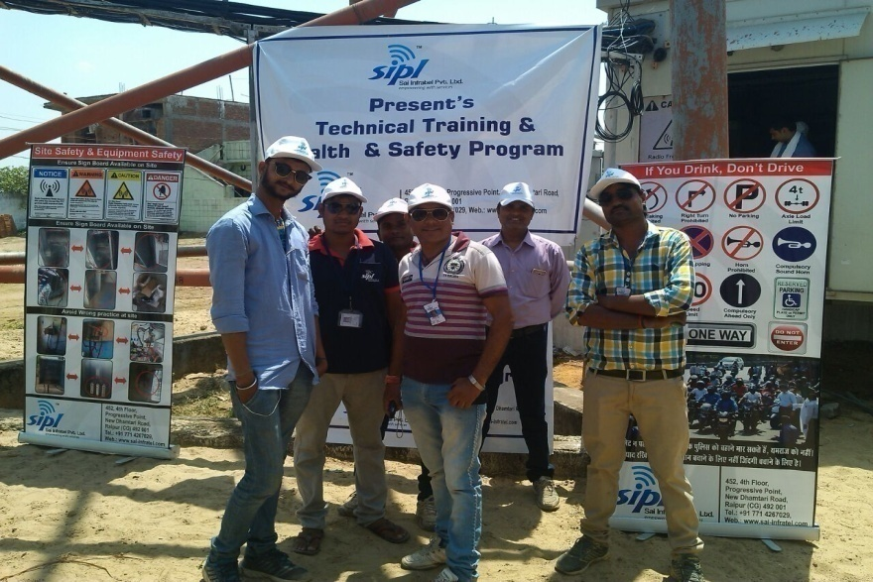
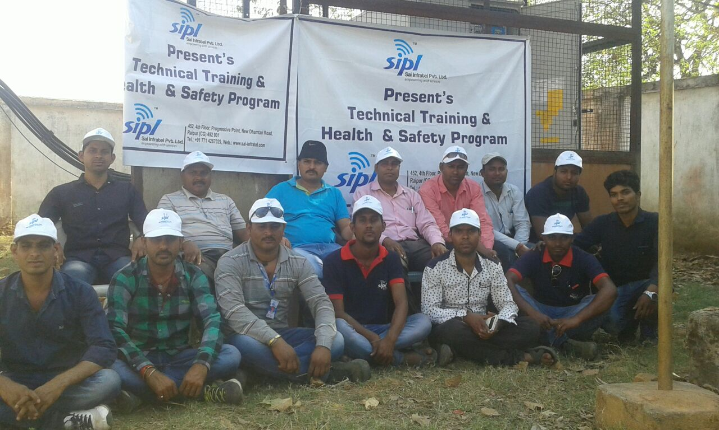
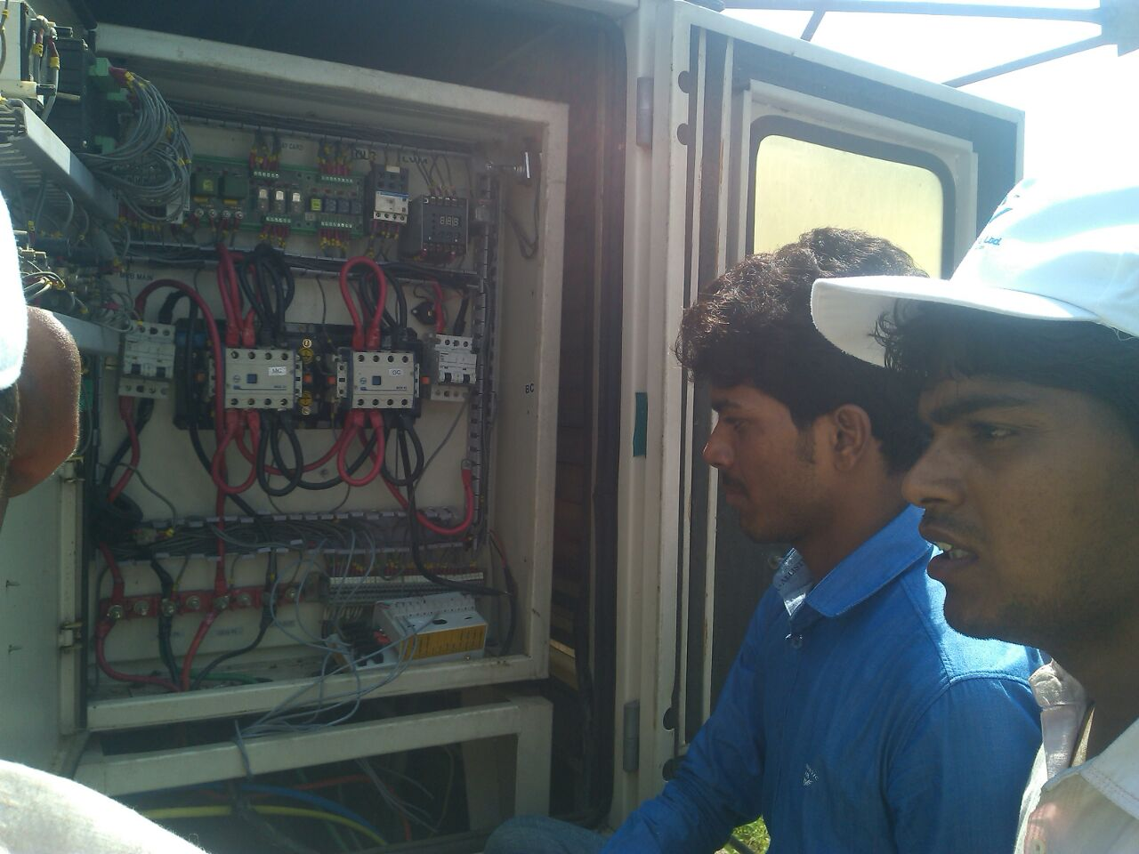
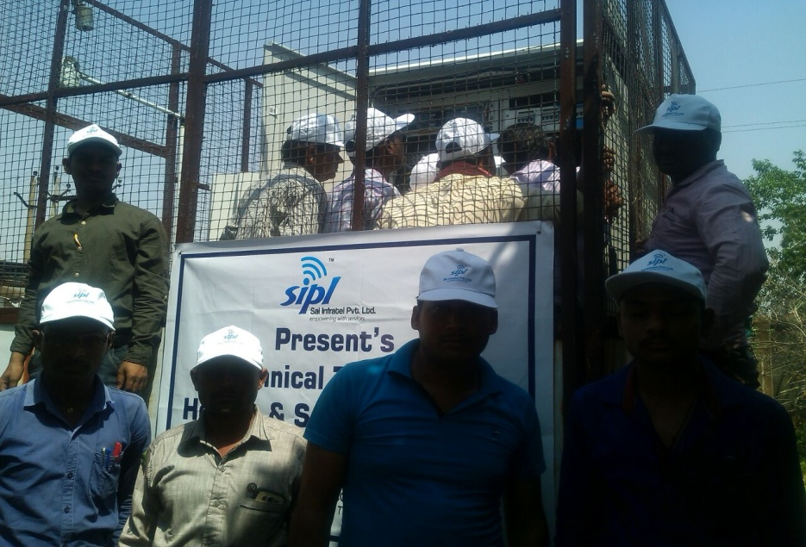
On Site Training

Slide 21
Initiative for O&M
Built Green Sites through removal DG set from sites.
Total Sites | Non DG Sites
815 | 52

Slide 22
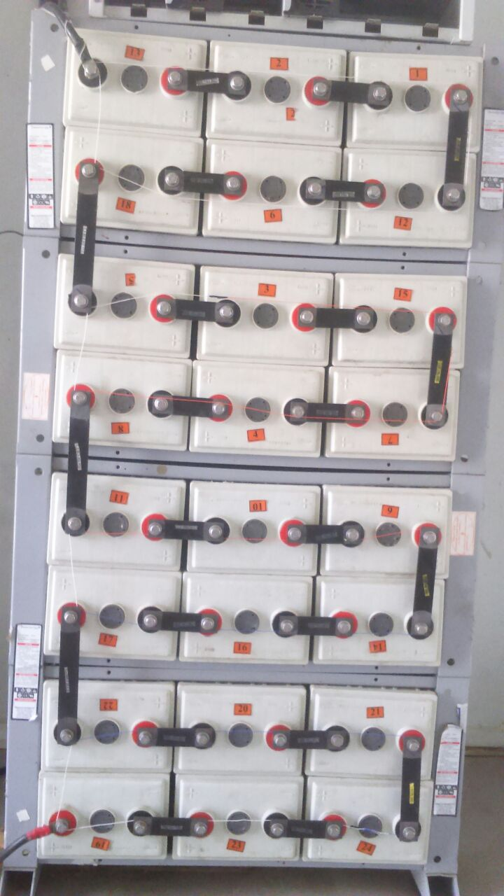
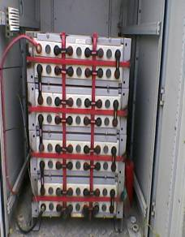
Initiative for O&M
Configure Battery Cell open alarm through route alarm cable in every cell for prevent battery bank theft issues.
Fabricate Battery Bank Cage for avoiding Battery bank theft issues.
Reduce Carbon foot print of sites through fuel deduction.
Tracking of all field staff for true movement on sites by mobile tracking system.
Cross verification mechanism for true PM by OMC through Alarm token system.
Daily reporting of field staff & site visit activity sharing on Whatsapp
EB Data Collection through software for smooth &speedy processing.
Mobile Application for ground team tracking & data collection.
Moving towards 100% digitalization for effective & best results.

Slide 23
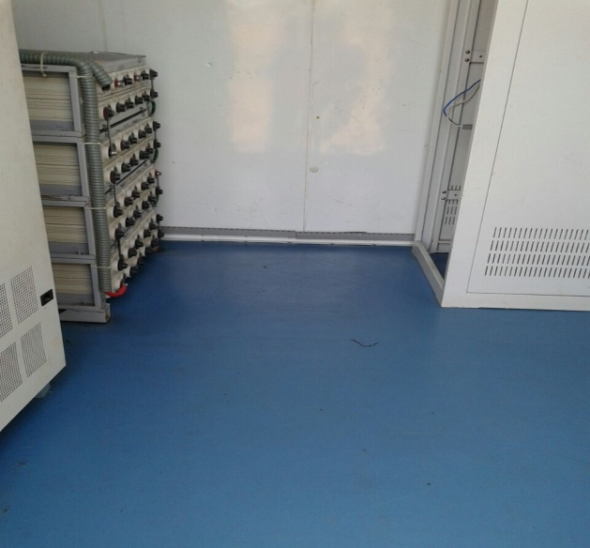
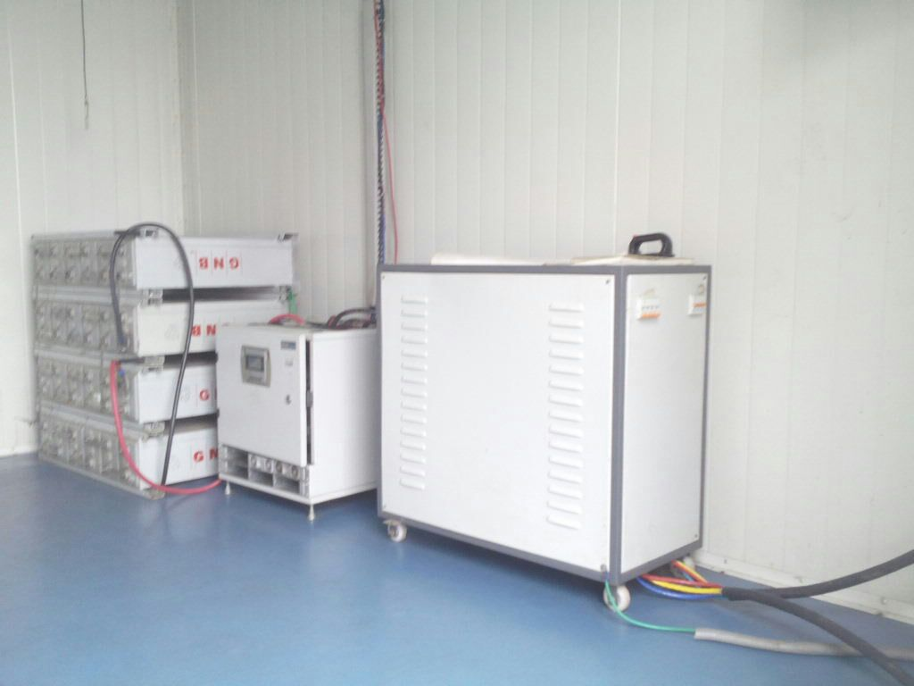
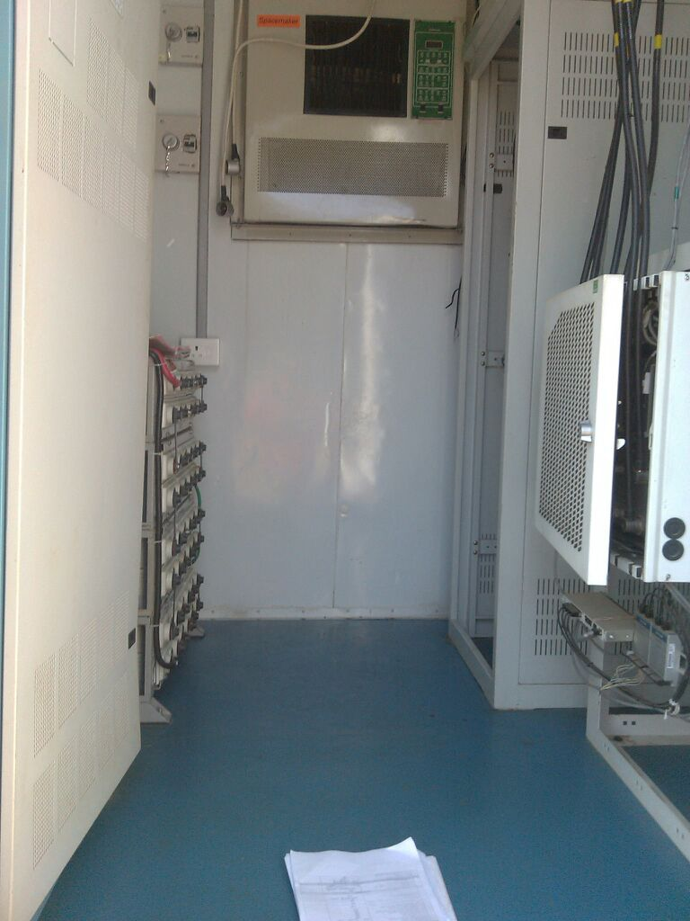
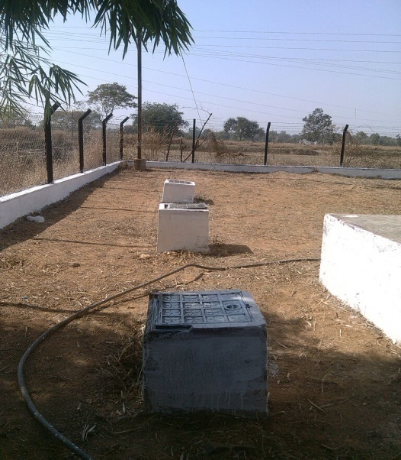
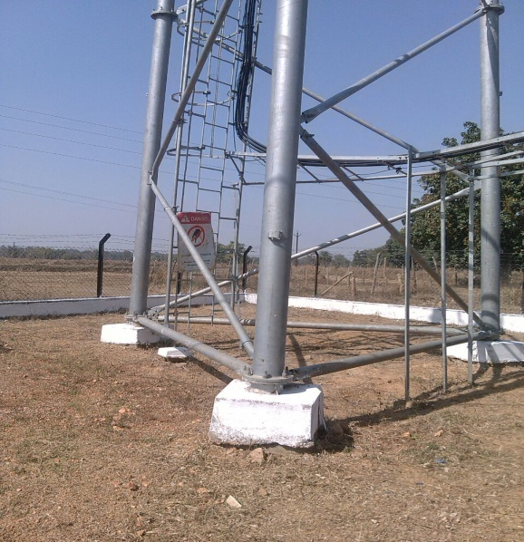
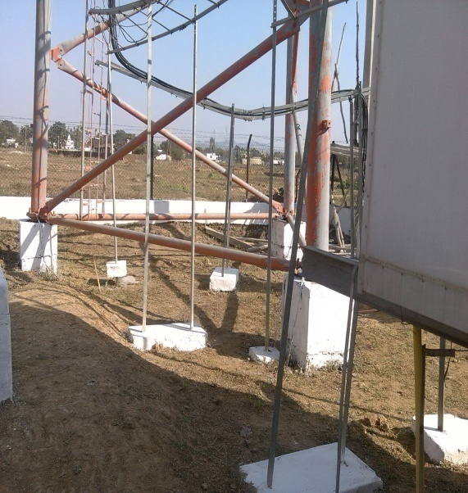
Initiative for O&M
“Project Clean” activity conduct every quarter for maintaining sites hygienic condition.

Slide 24
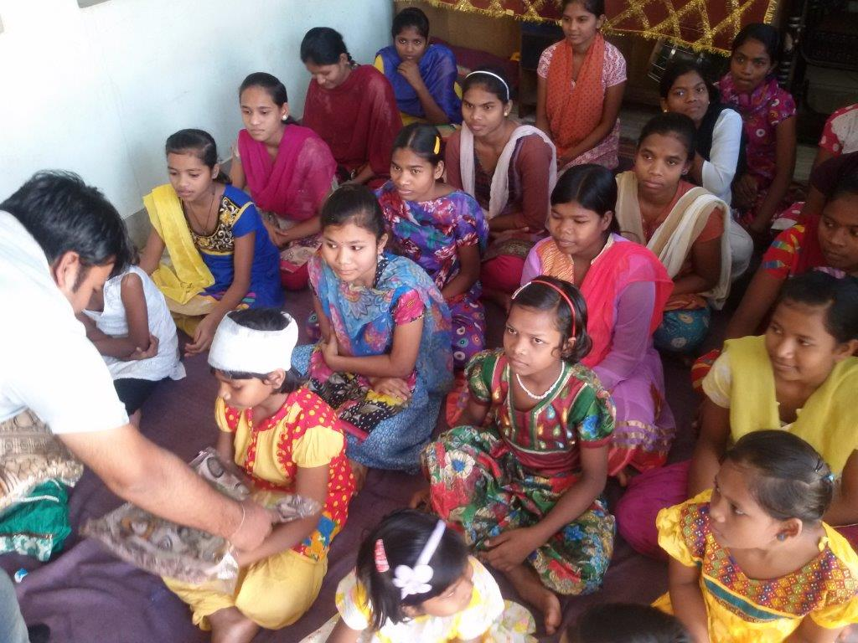
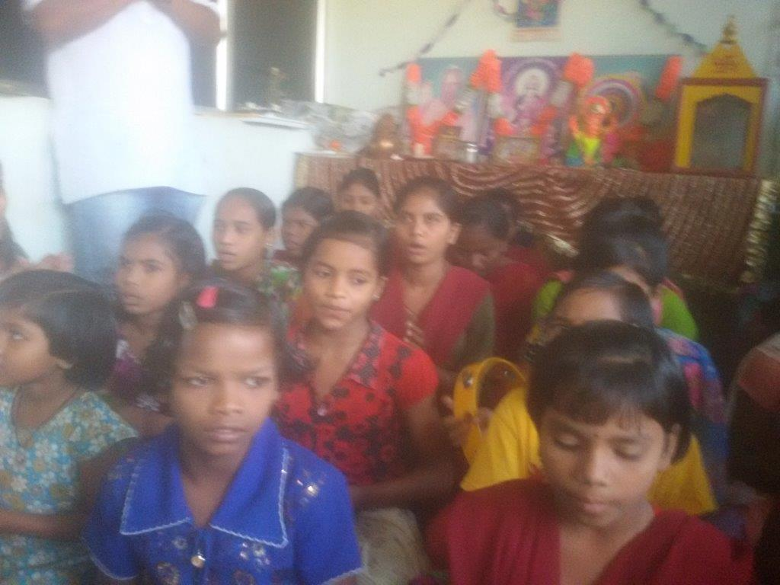
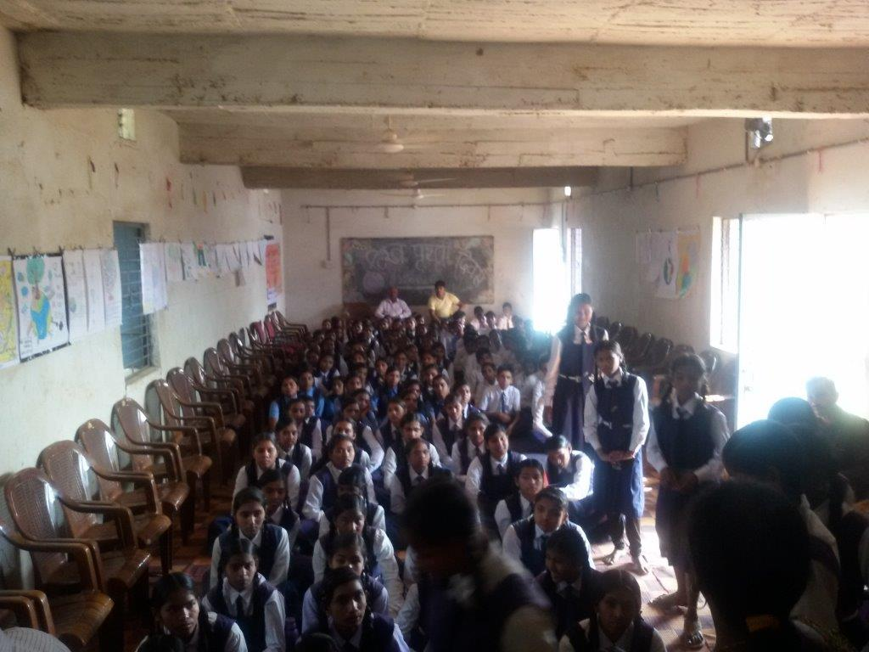
Corporate Social Responsibility
As a part to deliver something for society, SIPL doing some kind of Social work at:
MA Bhagwati Ashram, (Gayatri Hospital, Raipur)
Govt. Girls School, Datrenga
Sewa Vridh Ashram, Behind Telibandha Lake, Raipur

Slide 25
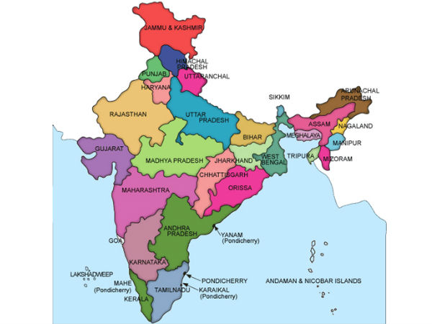
SIPL PRESENCE
Chhattisgarh
Odisha
Madhya Pradesh

Slide 26
Our Prestigious Clients
SIPL has strategic alliances with key players in all the segments to provide best services at optimal cost.

Slide 27
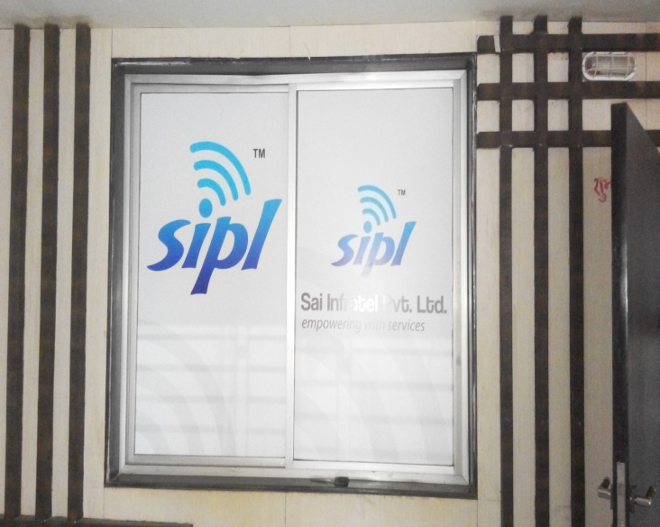
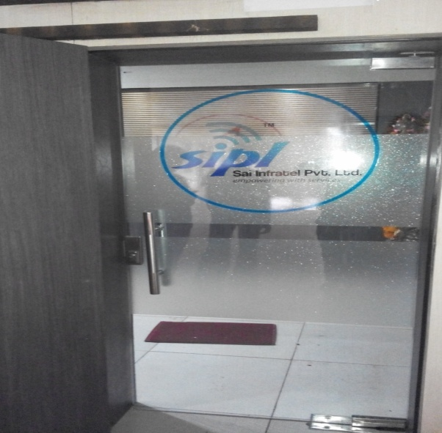
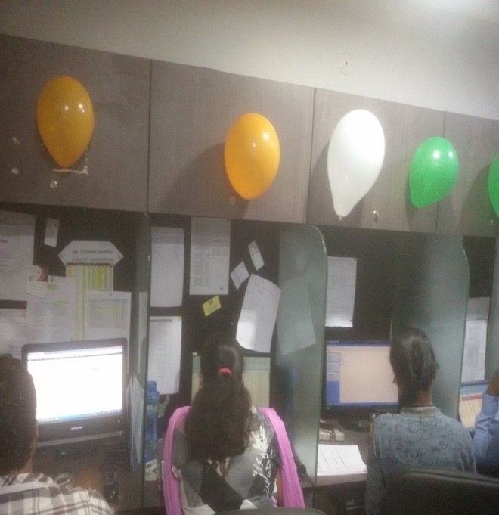
Infrastructure
SIPL is fully geared to establish communication and collaboration between clients and teams - onsite, offsite and, using best practices available today.

Slide 28
Contact Information
SIPL SAI Infratel Private Limited
Head Office: 452, 4th Floor Progressive Point,
New Dhamtari Road
Raipur-492001(C.G.)
Sales Office : 9, Ground Floor Progressive Point,
New Dhamtari Road
Raipur-492001(C.G.)
Mobile : 7773010111;7773010121;7773010103
Phone : 0771 4267029
E-mail : info@sai-infratel.com
: arjun.gupta@sai-infratel.com
: ajay.gupta@sai-infratel.com
Website: www.sai-infratel.com
www.facebook.com/Sai-Infratel-Pvt-Ltd

